Slide 1
QF2103 Project Trading Strategies Research
By Team 11: Albert, Nicholas, Akhil, Hamish, Stevan
Notes:
Hi everyone, we are from team 11 and today we will present our project on Trading Strategies Research

Slide 2
Table of contents
01
02
03
Data Preparation
Trading Strategy 1:
Stepwise Regression
Trading Strategy 2:
Support Vector Machine
Notes:
In this presentation, we will start with data preparation, followed by our first trading strategy using stepwise regression and second trading strategy using support vector machines.

Slide 3
01
Data Preparation
Notes:
Let me walk us through the first part of our presentation: data preparation

Slide 4
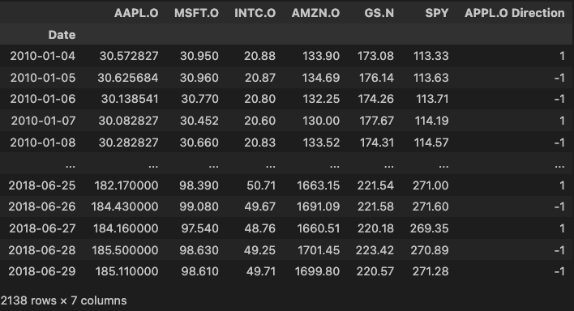
Initial Dataset
Notes:
Initially, we are given a dataset of end-of-day prices of these 5 stocks. We want to use them to create prediction of future stock price movement on which we will base our trading strategies.

Slide 5
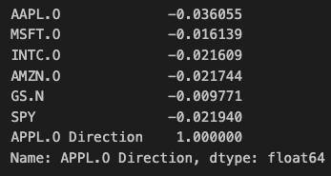
Preliminary Data Analysis
Notes:
Through preliminary analysis, however, we found that they have weak correlation coefficient of magnitude less than 0.04 with stock price direction, suggesting a limited prediction power of future stock price movement.

Slide 6
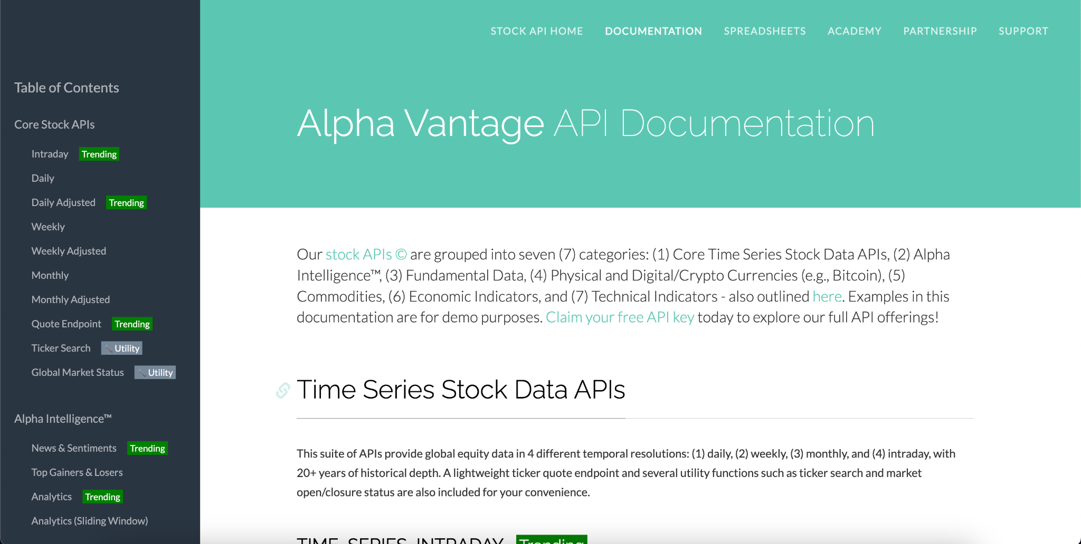
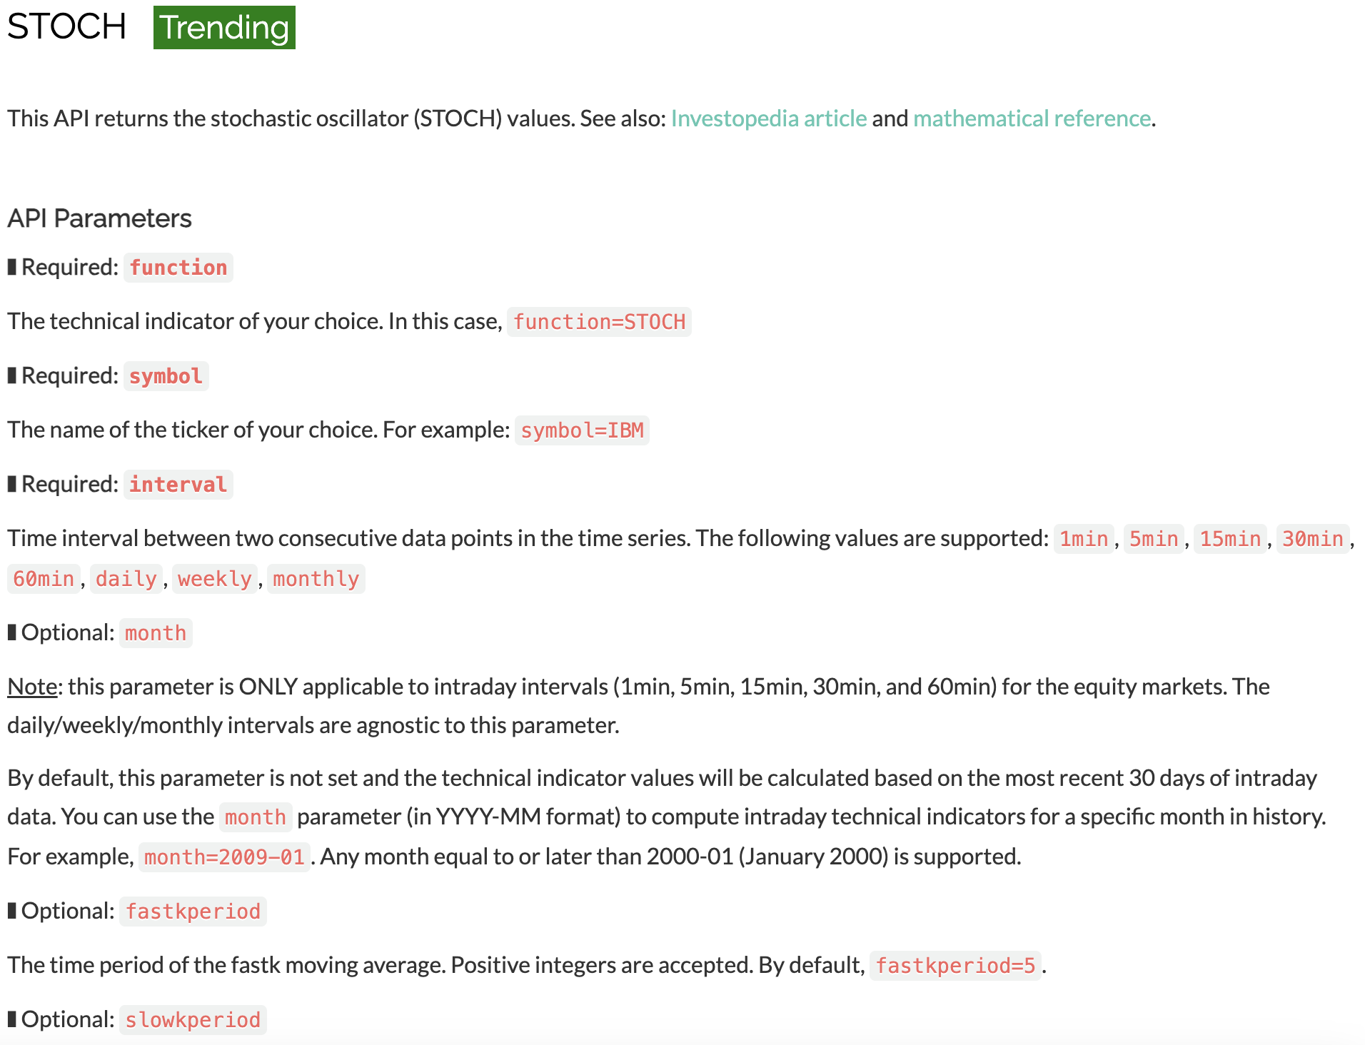
Data Collection
Notes:
Thus, we look for additional financial indicators online to improve our predictive power such as STOCH or stochastic oscillator which compares closing price with high-low range over a period to indicate potential overbought or oversold conditions.

Slide 7
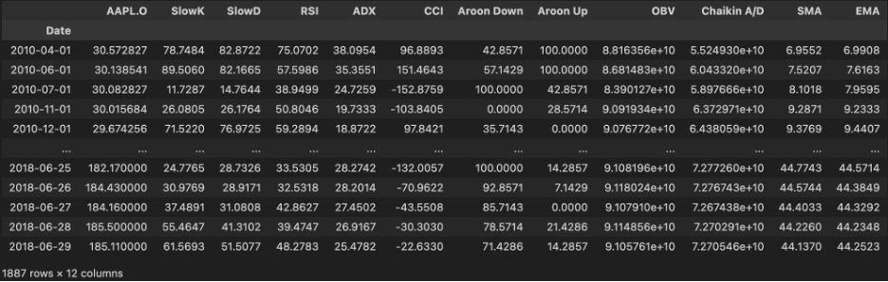
Data Collection
Notes:
Overall, for each stock, we collected 11 additional financial indicators such as RSI, ADX and CCI.
Now, I will now pass the time to hamish to talk about how we use these to implement our first trading strategy using stepwise linear regression model.

Slide 8
02
Trading Strategy 1:
Stepwise Regression

Slide 9
Overview of Stepwise Regression
Linear regression
Feature Selection
Forwards vs Backwards
Drawbacks
Notes:
Stepwise regression is the combination of Linear Regression with Feature Selection. It is a technique that attempts to optimize a Linear regression model by choosing the most statistically significant predictors by either forward or backward feature selection (or a combination of both). Forward feature selection starts with no predictors, and adds predictors one-by-one based on the most statistically significant contribution to the linear regression model (to measure this we look at the highest difference in adjusted R-squared between the models). Backward feature selection starts with all the predictors and iteratively removes predictors based on the least statistically significant contribution to the model (eg. lowest difference in adjusted R-squared). Stepwise regression can suffer severely from overfitting, as we are forcing the data to give us a pattern, so it is important to select the predictors carefully such that we can expect some significance in predicting the stock price.

Slide 10
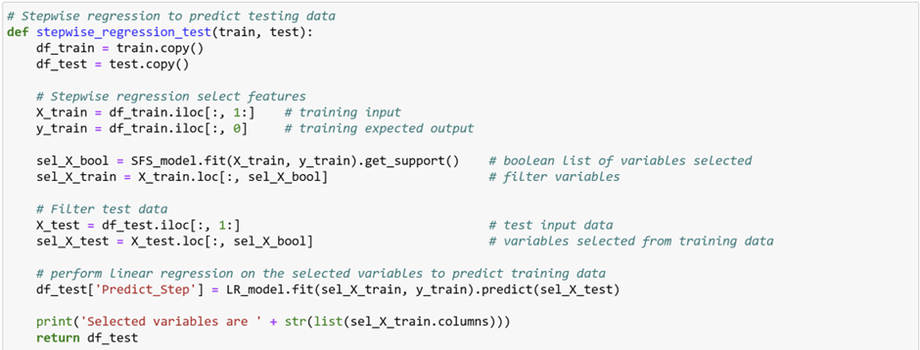
Feature Selection
Notes:
Most of the work in this function is done by the SFS_model.fit() command, which performs forward feature selection (with respect to a Linear regression model) on the training data. Then we use the corresponding selected predictors from the test data to evaluate a linear regression model which predicts a return value from the test data.

Slide 11
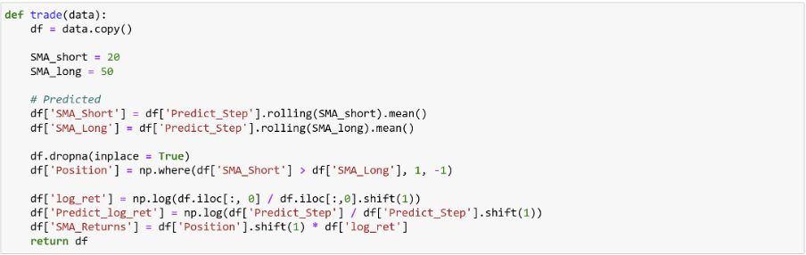
Trading Strategy
Notes:
The main trading strategy using the SMA is to detect when the SMA_short crosses the SMA_Long and wherever it crosses, then we denote its position as +1 otherwise -1.
Here +1 denotes SMA_Short>SMA_Long which indicates that the stock price might go up so one should buy the stock whereas -1 indicates that the stock price might go down so one should sell the stock by making a trade. After the positions for each day is computed, the SMA_Returns is calculated to be compared with the benchmark case.

Slide 12
Features selected
 | SlowK | SlowD | RSI | ADX | CCI | Aroon Down | Aroon Up | OBV | Chaikin A/D | SMA | EMA
AAPL.O
MSFT.O
INTC.O
AMZN.O
GS.N
Notes:
Features selected
Performing linear regression on selected features…

Slide 13
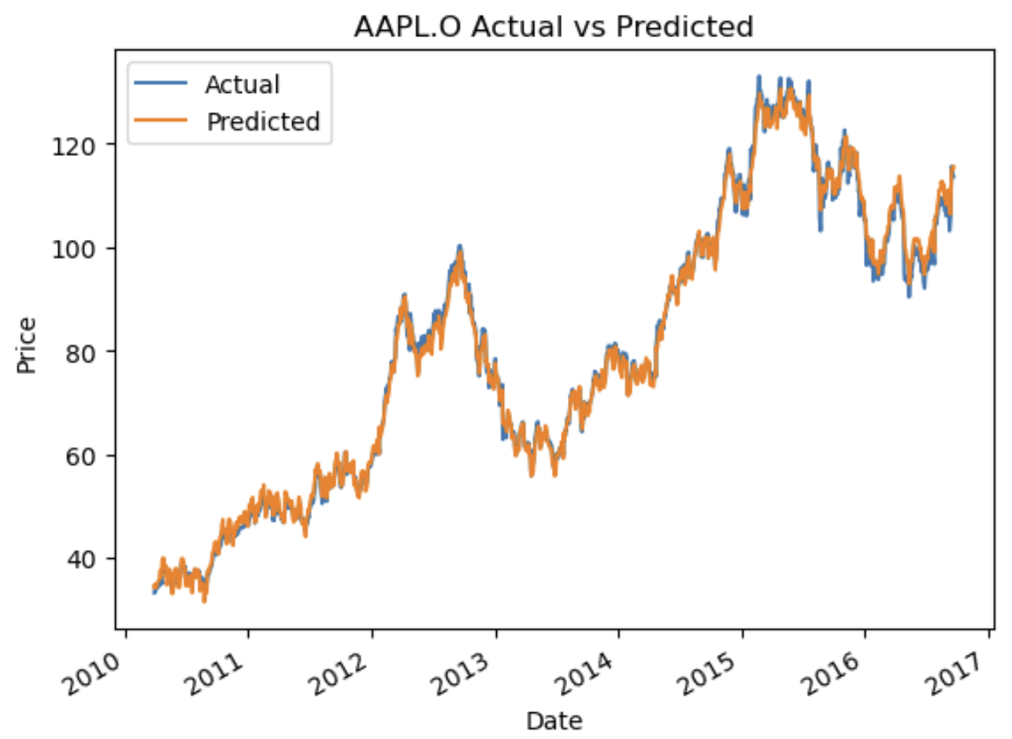
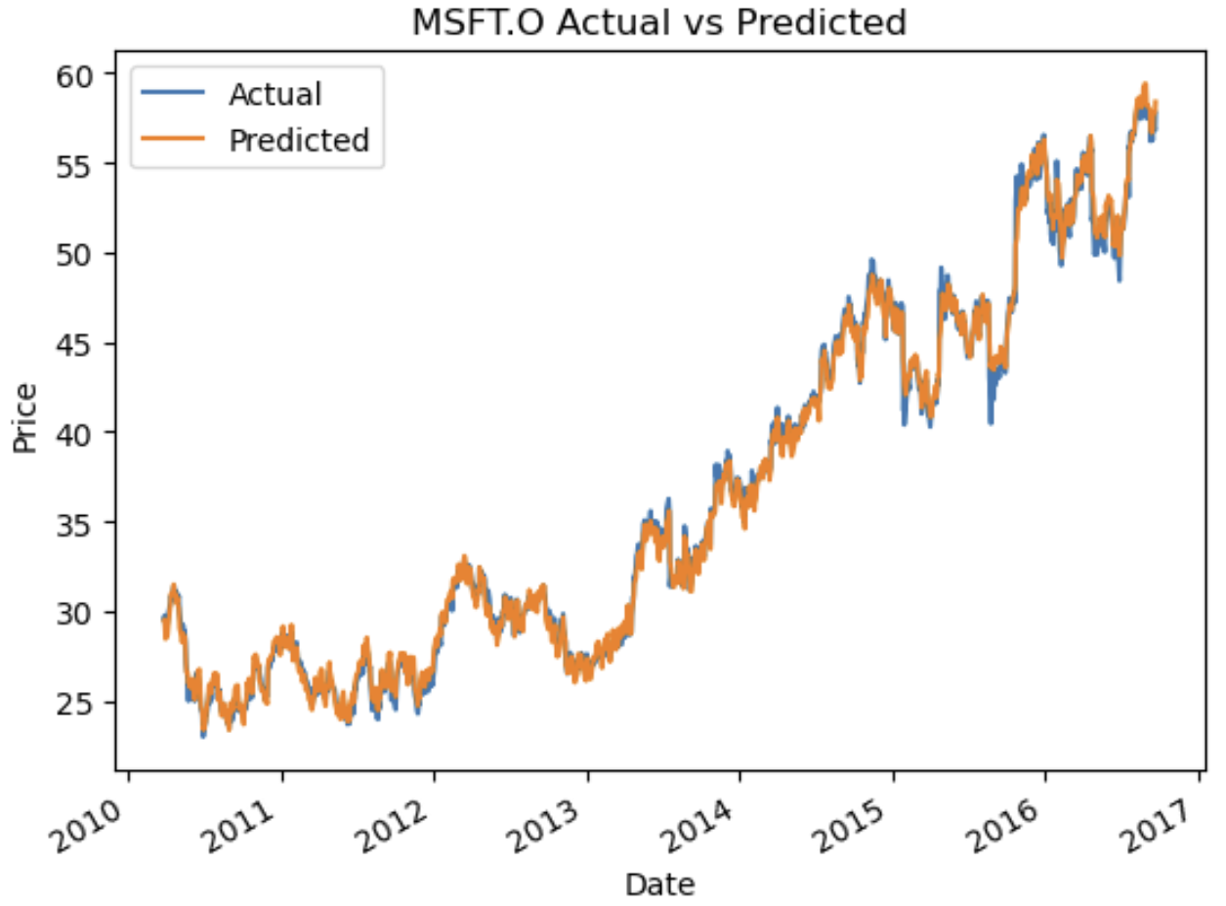
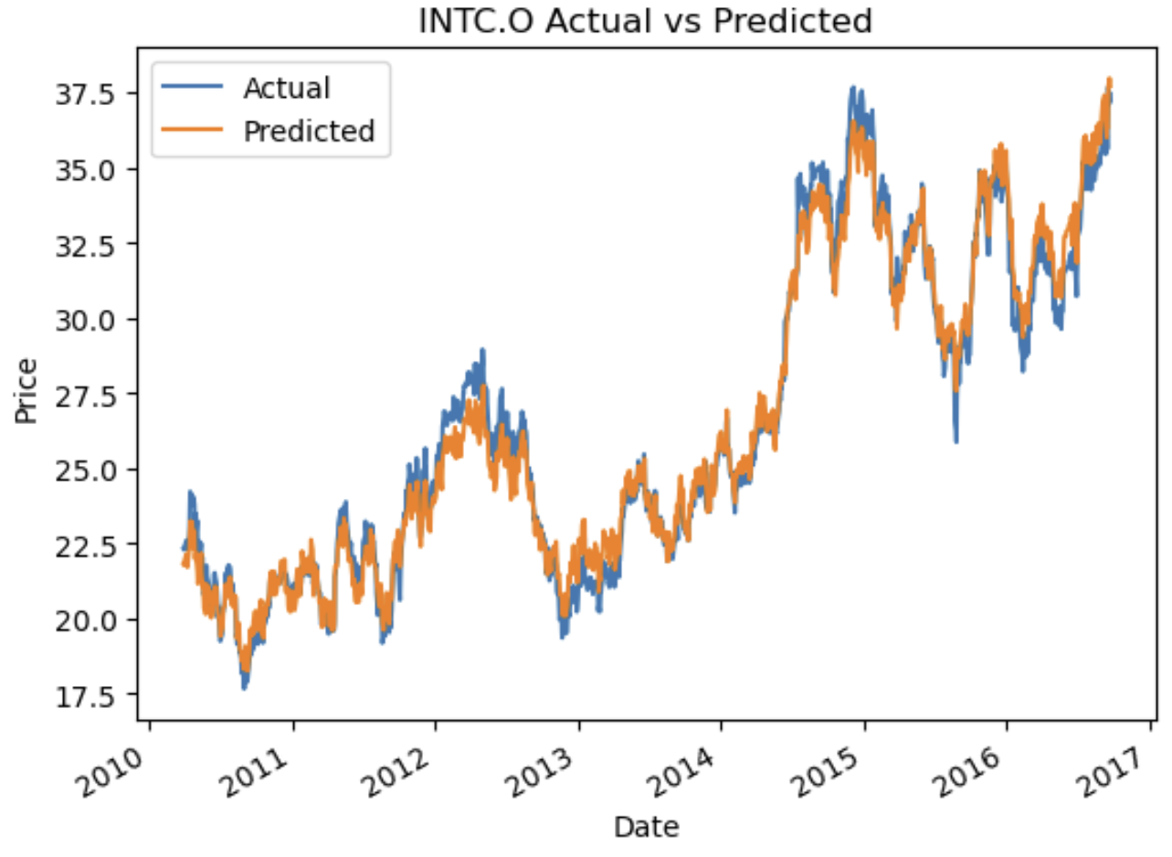
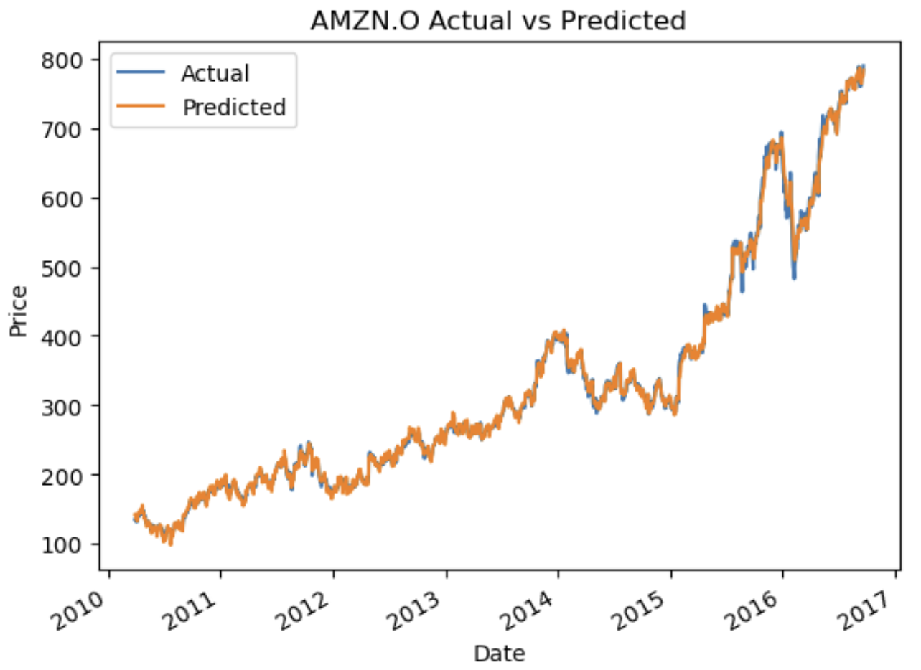
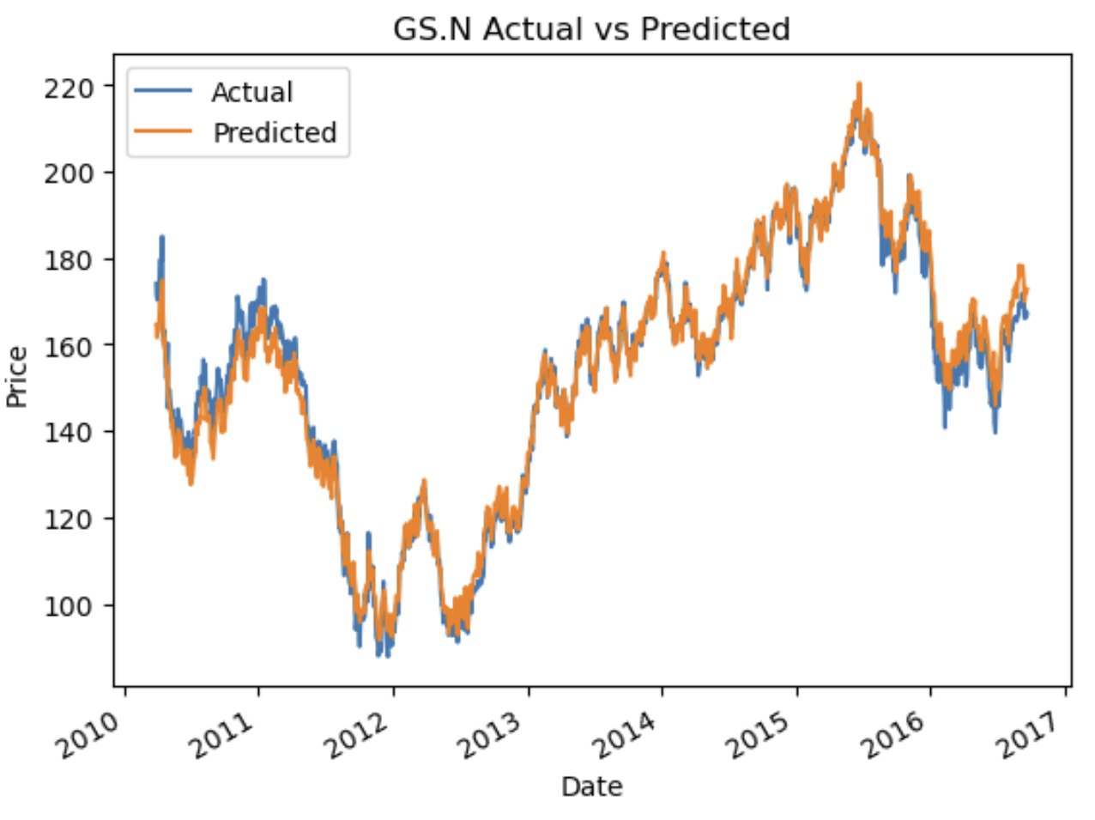
Notes:
Prediction on training data
Now performing the same linear regression on the testing data…

Slide 14
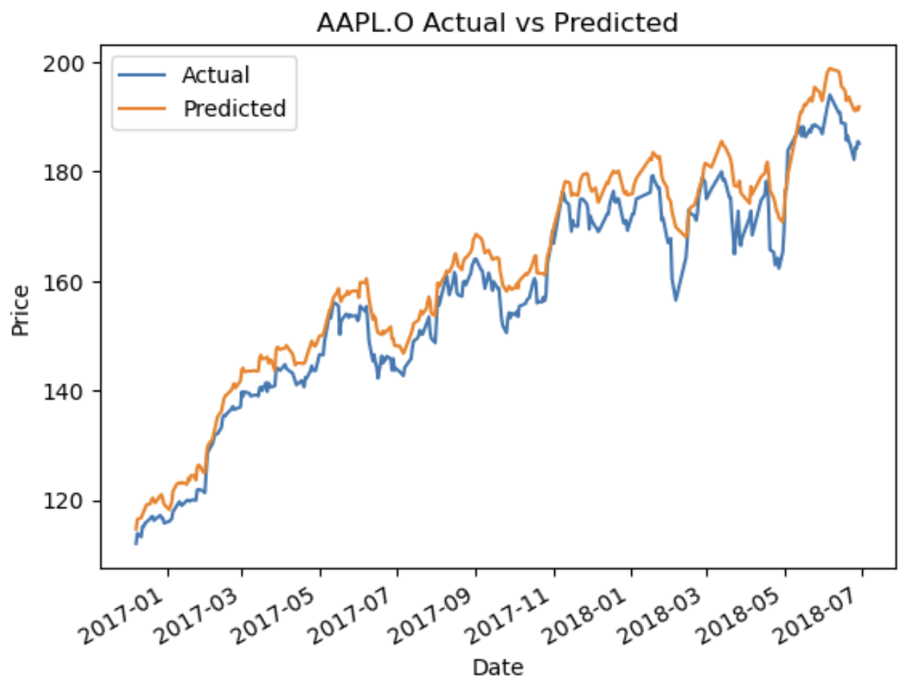
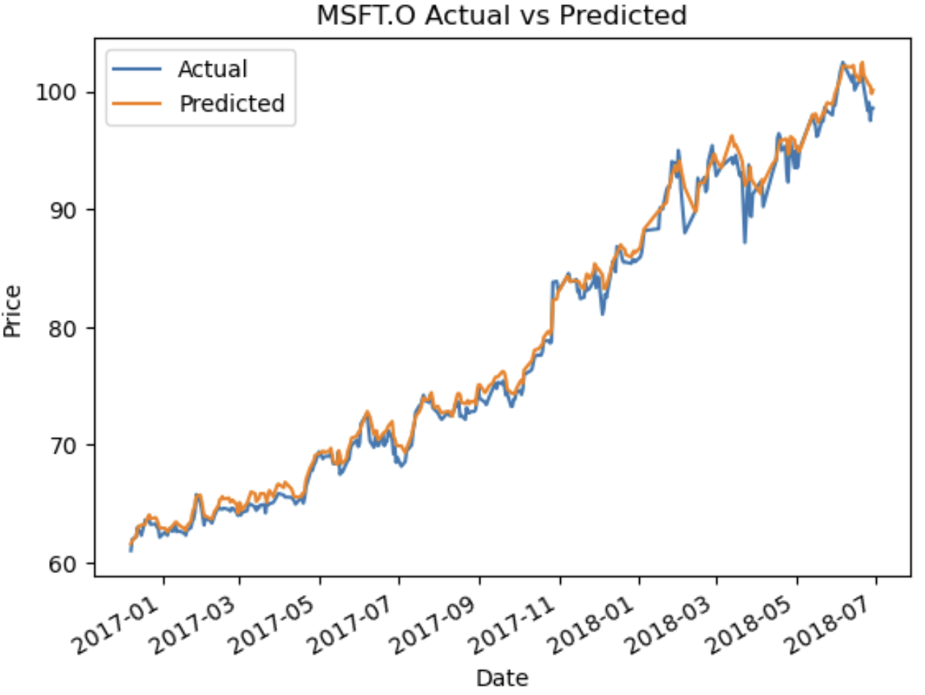
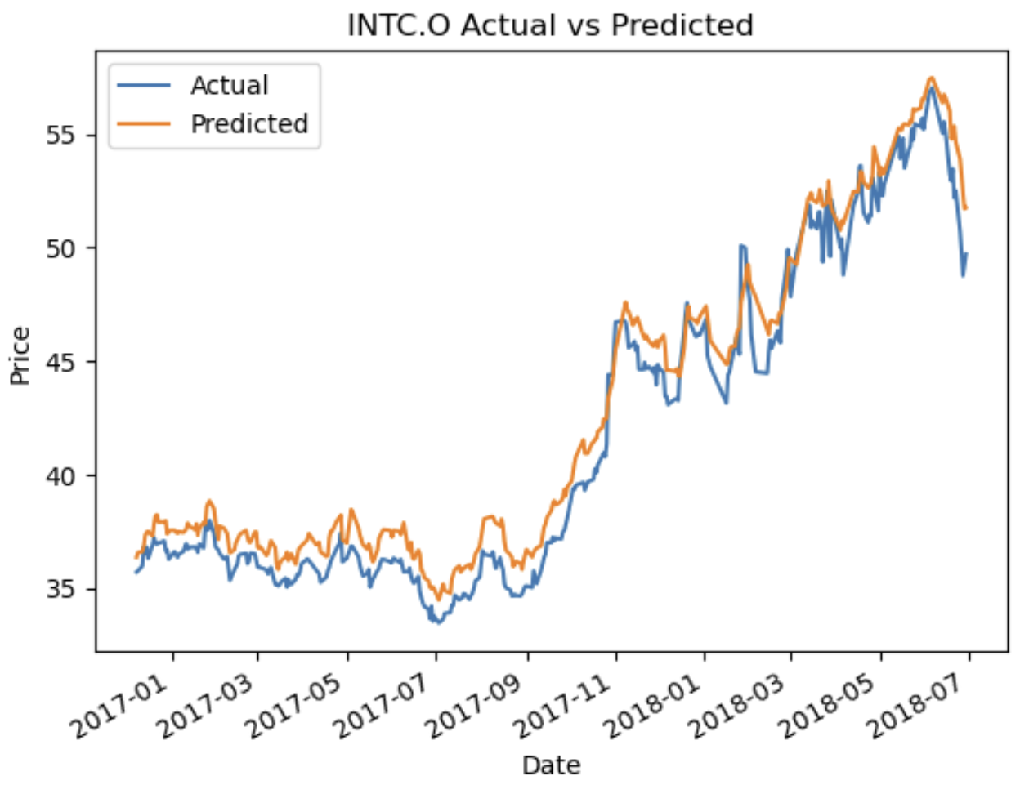
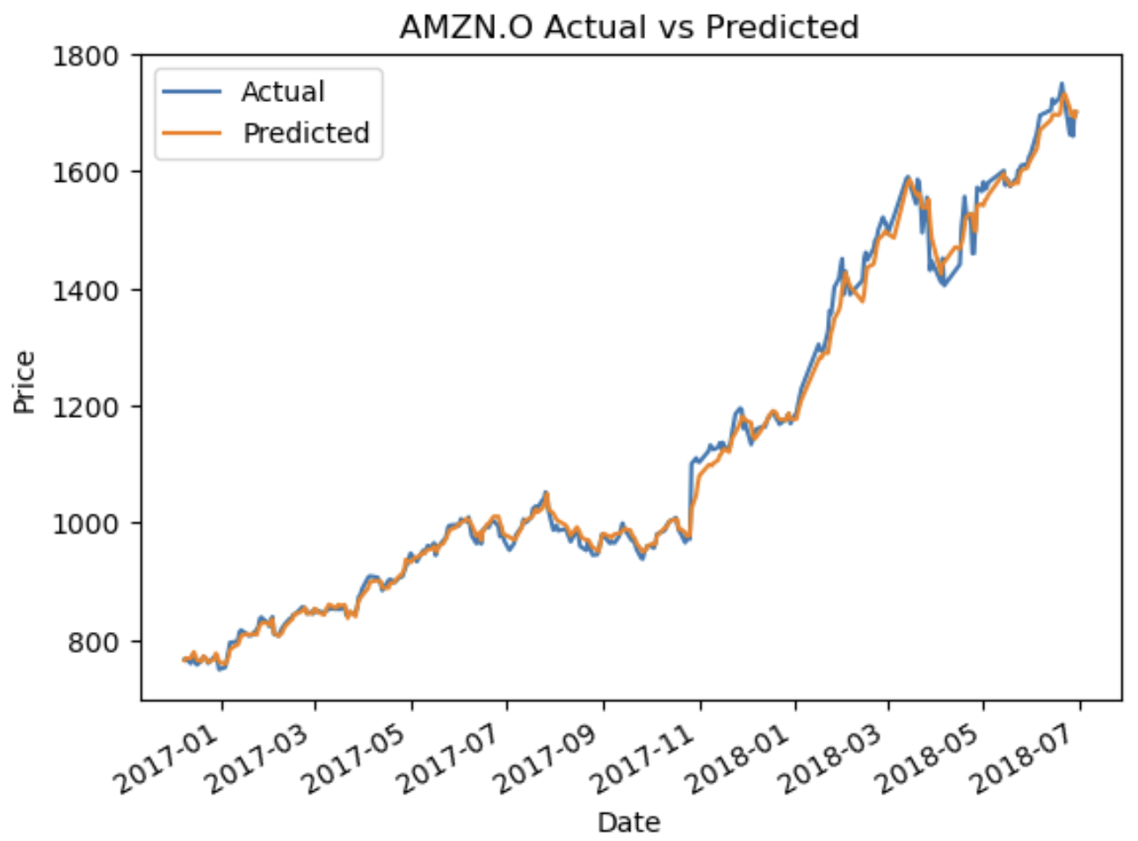
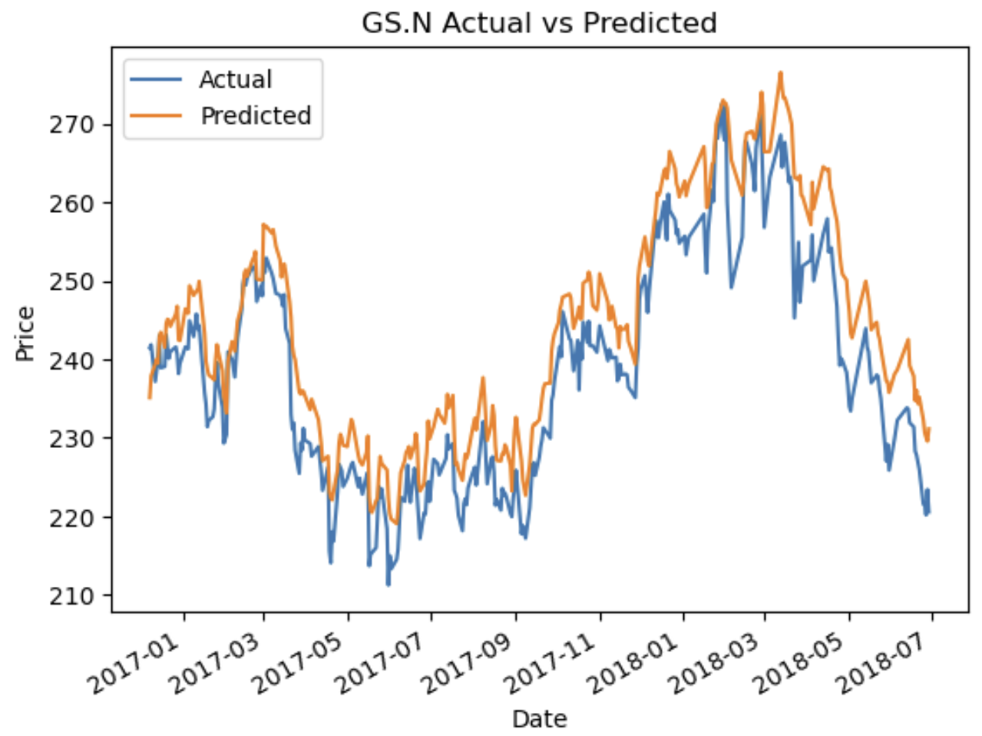
Notes:
Prediction on test data
Using predicted price, we perform a SMA trading strategy on the stock

Slide 15
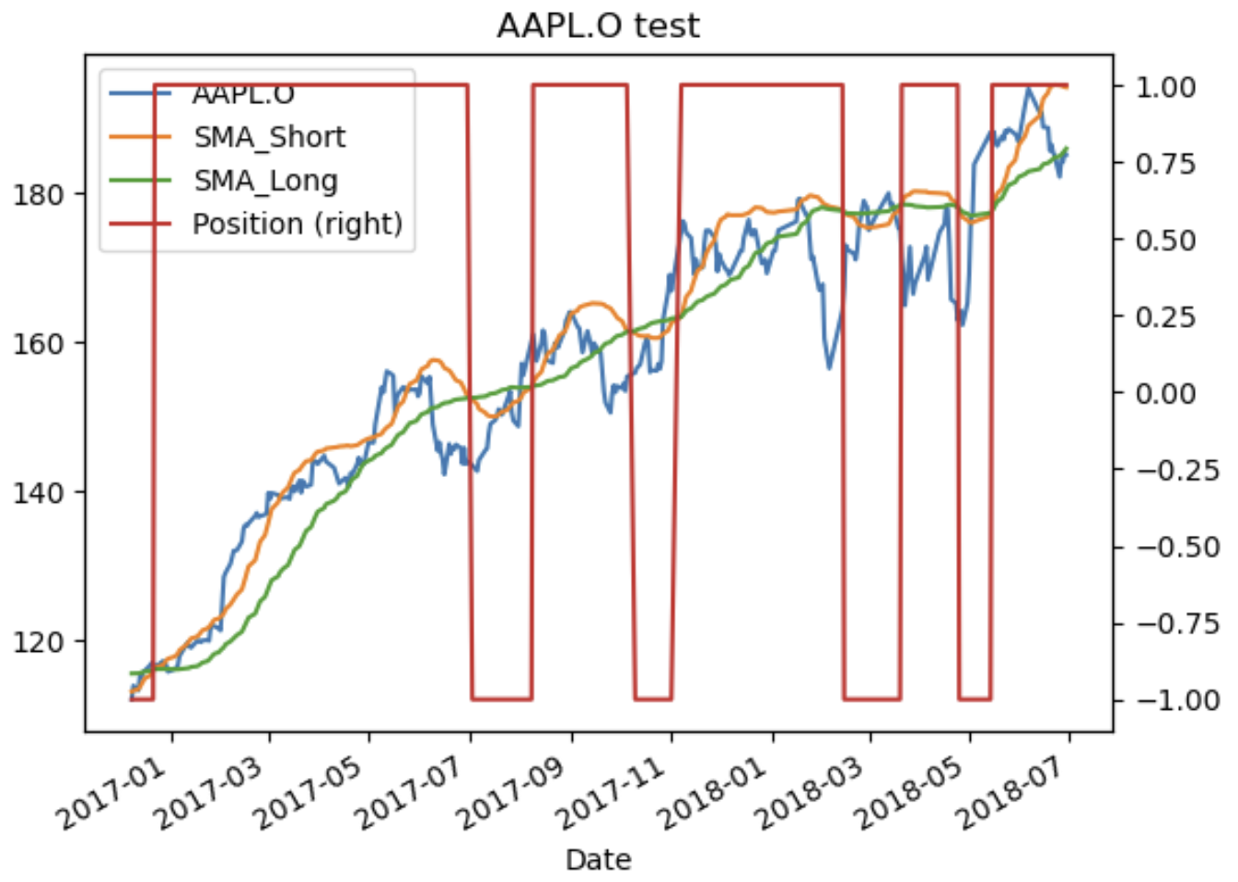
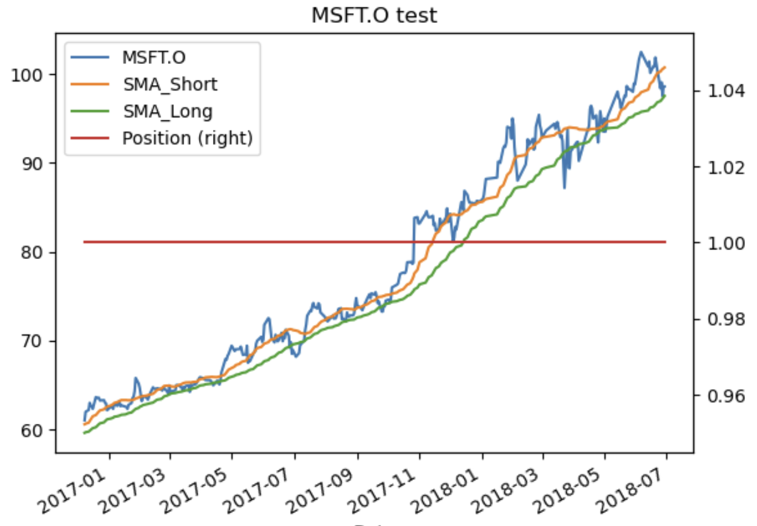
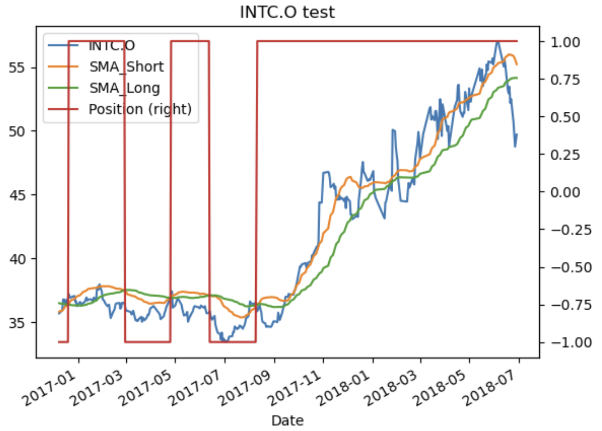
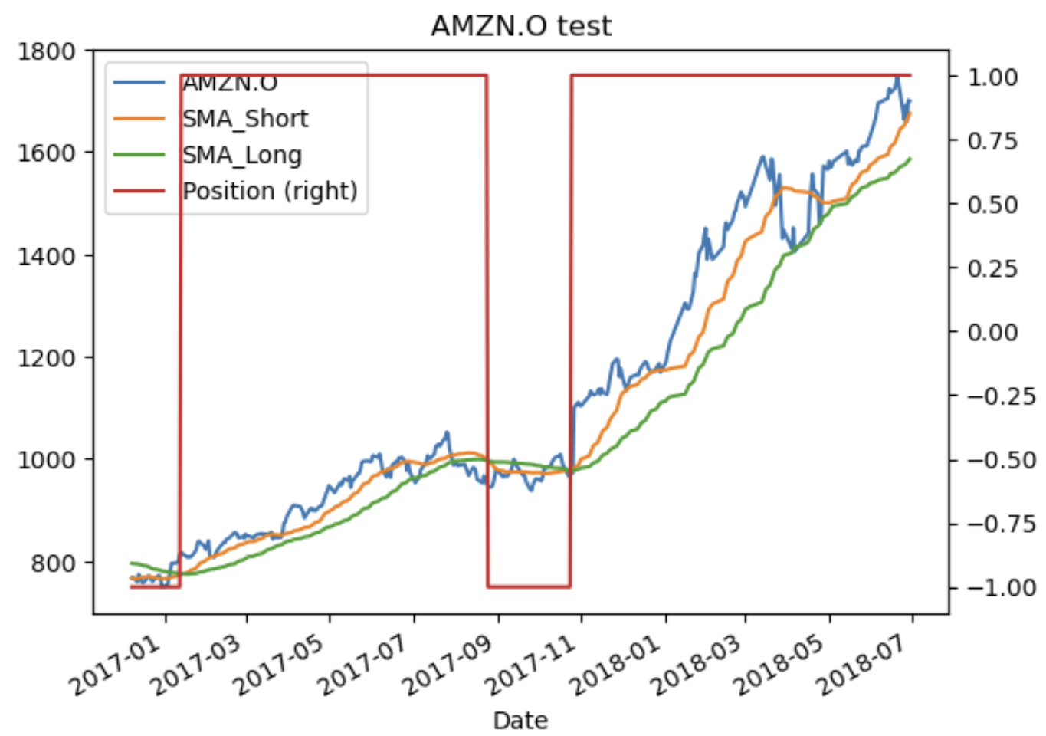
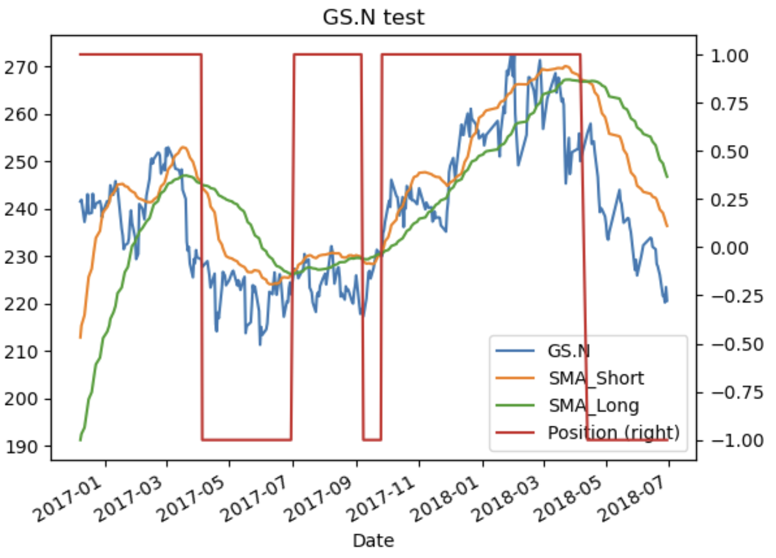
Notes:
Illustration of SMA trading on testing data
Positions taken at each of the respective time points
Now lets look at the statistics

Slide 16
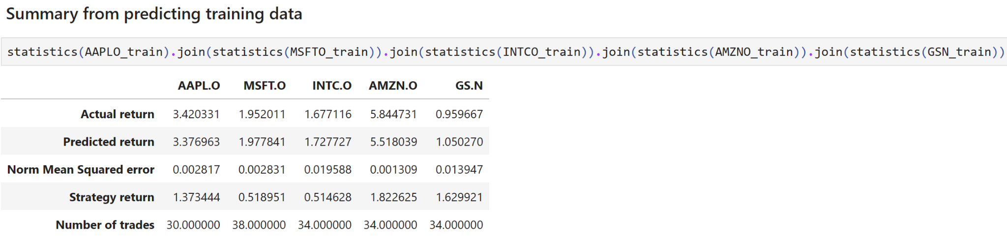
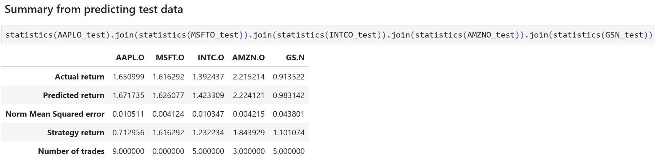
Results
Train data
 | SMA_short | SMA_Long
AAPL.O | 20 | 50
MSFT.O
INTC.O
AMZN.O
GS.N
Test data
 | SMA_short | SMA_Long
AAPL.O | 20 | 50
MSFT.O
INTC.O
AMZN.O
GS.N
Notes:
Result fixed SMA period
Appple and Goldman sachs underperformed, Microsoft and intel opposite
Can we further optimize our returns…

Slide 17
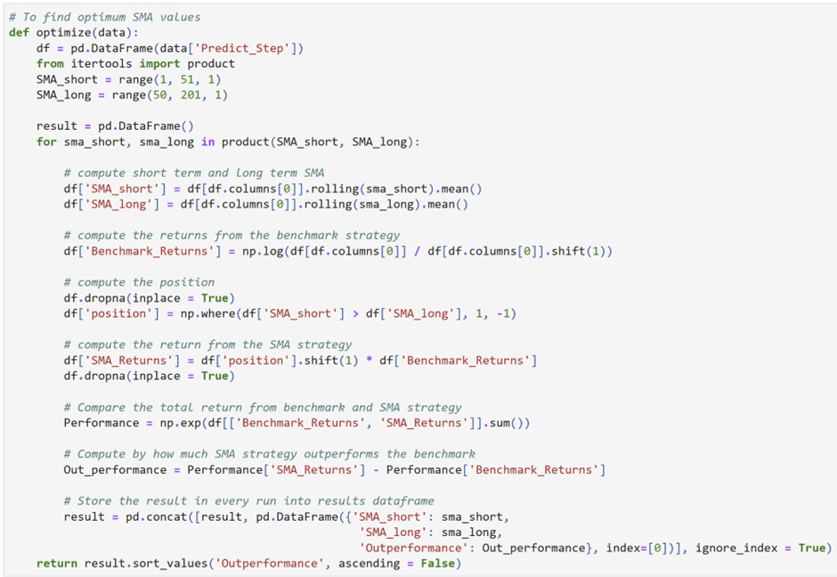
Optimum SMA period
Prior assumption:
20/50 period crossover significant
However, different period different return
Aim: use our predicted price, select optimal SMA period to use
Notes:
Rationale to optimize
Aim to use predicted price, perform brute force optimization to select the optimal SMA period to maximise returns

Slide 18
Train data
 | SMA_short | SMA_Long
AAPL.O | 1 | 60
MSFT.O | 26 | 50
INTC.O | 1 | 68
AMZN.O | 1 | 64
GS.N | 1 | 52
Test data
 | SMA_short | SMA_Long
AAPL.O | 26 | 50
MSFT.O | 26 | 50
INTC.O | 1 | 55
AMZN.O | 1 | 51
GS.N | 1 | 51
Notes:
Optimum periods for respective data
These are the new periods chose
Now lets see how our positions have changed

Slide 19
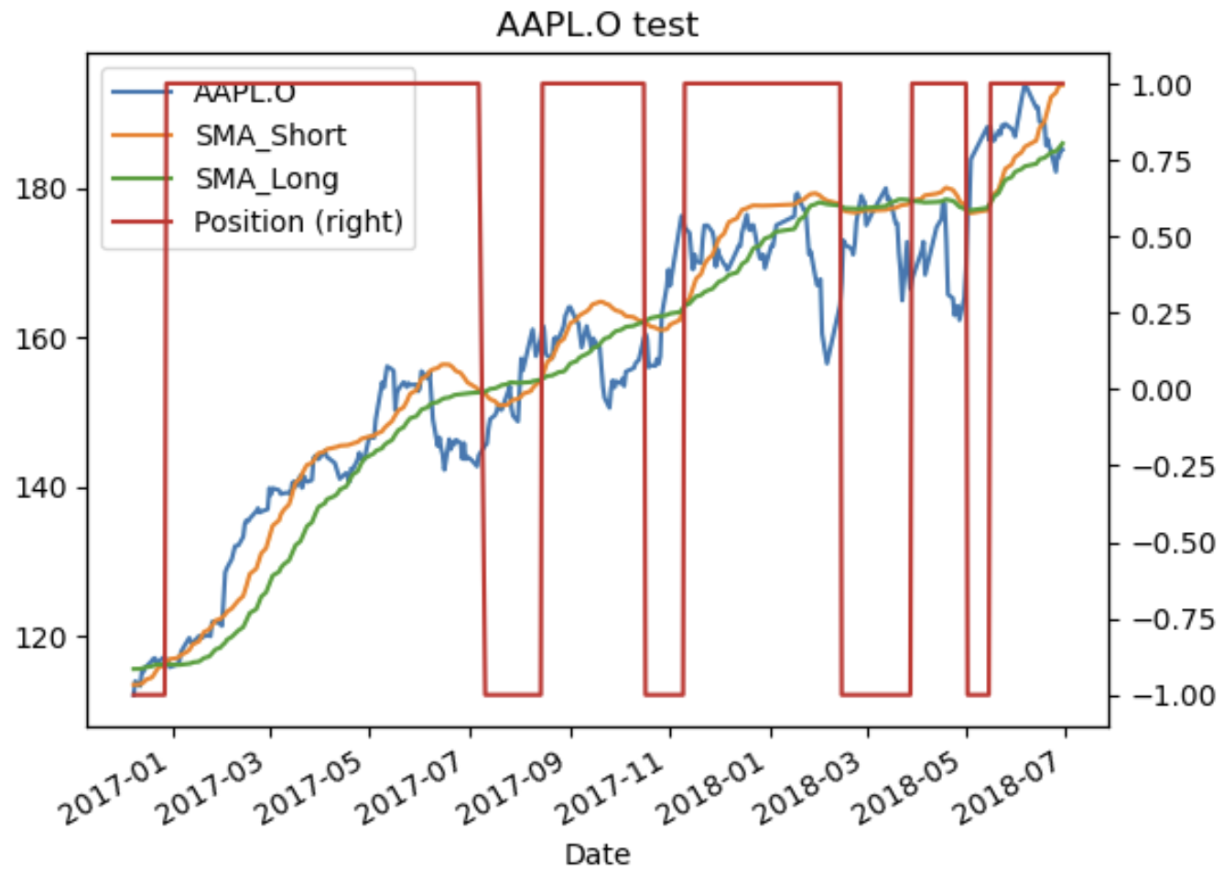
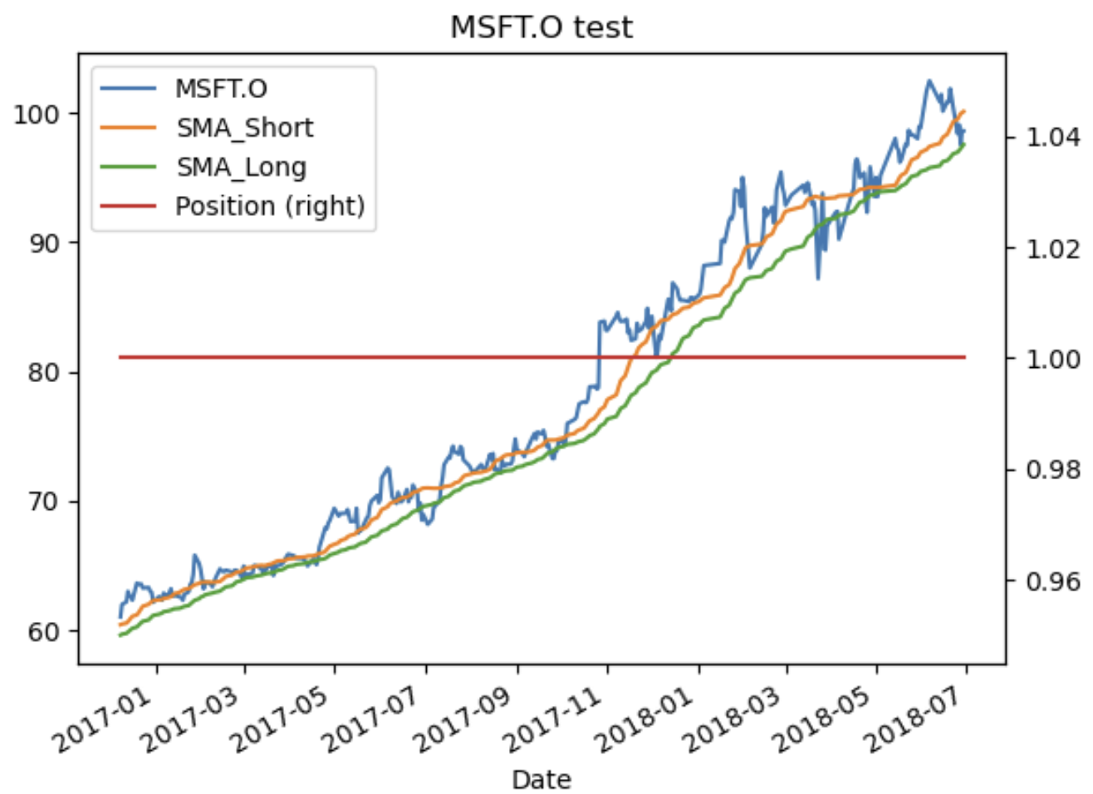
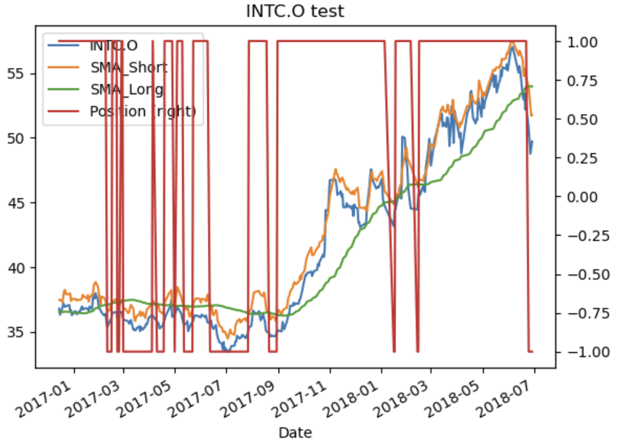
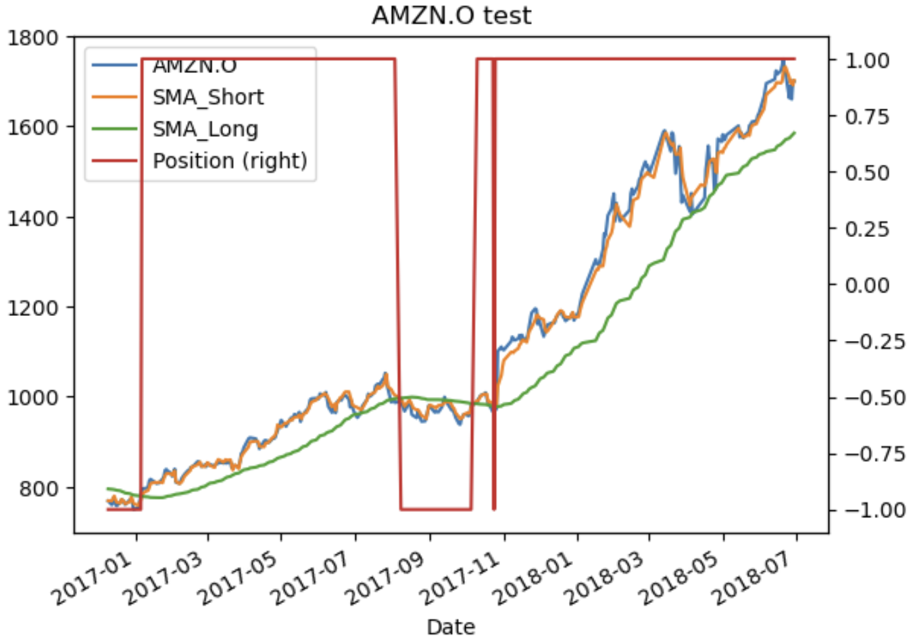
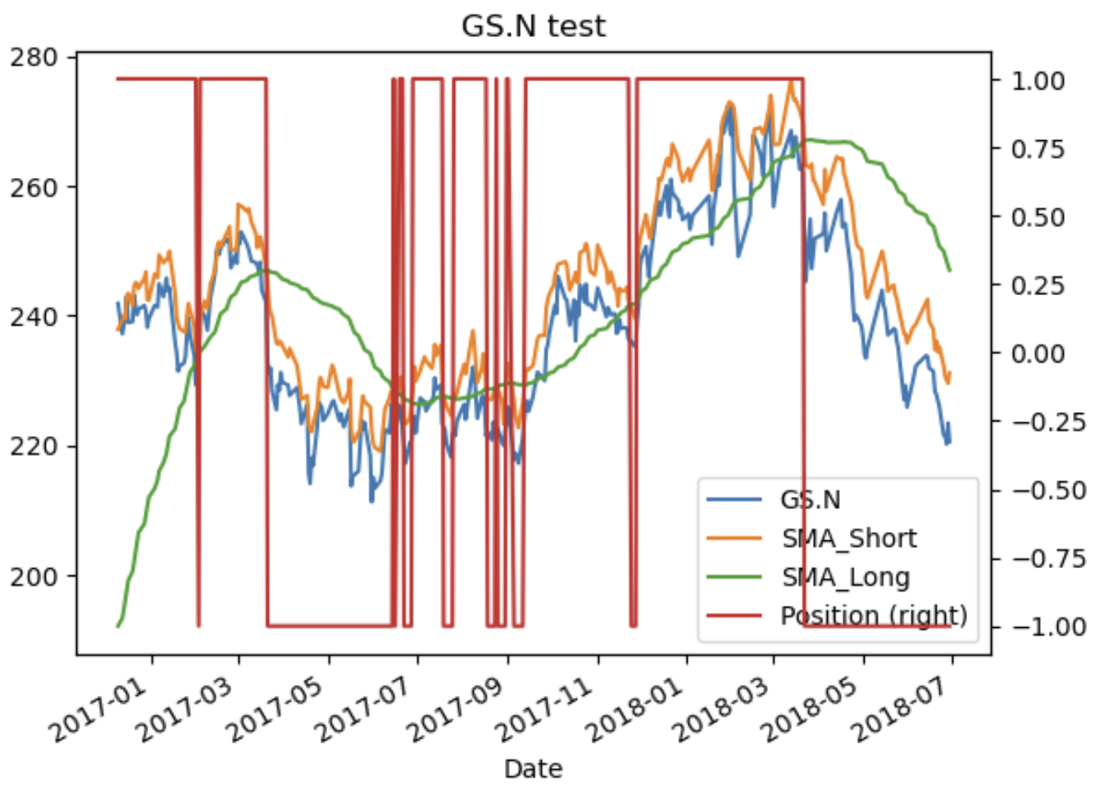
Notes:
Trading with new period
These are the positions taken for the new periods

Slide 20
Comparing returns
Training
 | Unoptimised | Optimised
AAPL.O | 1.373444 | 2.125161
MSFT.O | 0.518951 | 0.689024
INTC.O | 0.514628 | 1.185780
AMZN.O | 1.822625 | 1.555400
GS.N | 1.629921 | 1.92383
Testing
 | Unoptimised | Optimised
AAPL.O | 0.712956 | 0.912977
MSFT.O | 1.616292 | 1.616292
INTC.O | 1.232234 | 1.078916
AMZN.O | 1.843929 | 2.085940
GS.N | 1.101074 | 0.984166
Notes:
Analyse improvements from optimisation
Most stocks see greater returns. However some stocks saw a fall in returns

Slide 21
03
Trading Strategy 2:
Direction Prediction using Support Vector Machine
Notes:
In our second strategy, we use Support Vector Machine to predict direction of stock price movement

Slide 22
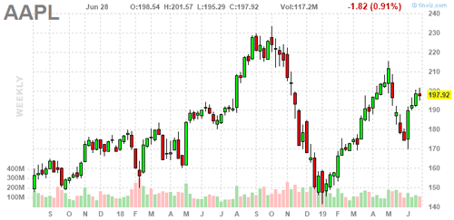
Trading Strategy Logic
Notes:
The trading strategy is as follow:
Every day, we will do one trade, if we predict that tomorrow’s price will rise, we take a long position of 1 unit and conversely, if we predict that tomorrow’s price will fall, we will take a short position of 1 unit.
If our prediction is right, we make a profit of the absolute difference between today’s and tomorrow’s price otherwise, we make a loss of this amount.
Now, I will pass the time to stevan who will walk us through how we train and optimize our Support Vector Machine to perform this prediction and the result of this strategy

Slide 23
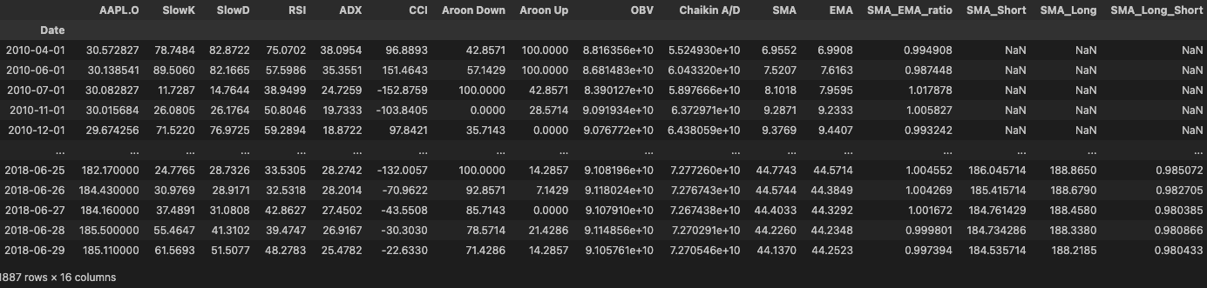
Machine Learning Training and Optimization 1:
Feature Creation
Notes:
Thanks Albert, now I’m going to talk about the technical details of our svm model. We first created some new features, in hope that they would produce better correlation with the price change, either on its own or in combination with other features. We created them using SMAs and EMA.

Slide 24
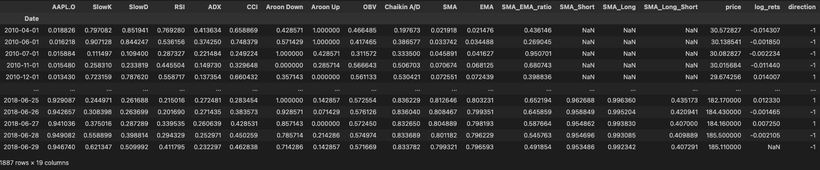
Machine Learning Training and Optimization 2:
Data Normalization
Notes:
Next, we see that all the columns have different scale of values, thus, we normalized them so the model can equally weight them and it is easier for us to interpret the result also. We do kept normal price and log returns for statistics later on and graph generations.

Slide 25
Machine Learning Training and Optimization 3:
Split to Train and Test Data with Ratio 0.8
Notes:
Next we performed sequential split of ratio 0.8 to X_train, y_train, X_test, y_test as well as log returns of test data for return statistics calculation

Slide 26
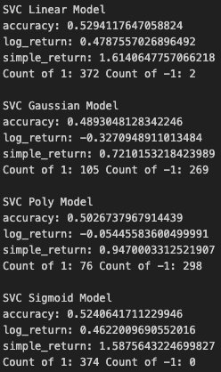
Machine Learning Training and Optimization 4:
SVM Kernel Model Selection
Notes:
We tried numerous models, MLPClassifier, HMM, KNN, before choosing to focus on SVM. And among all the kernels, we choose poly as we believe it would give us the best result.

Slide 27
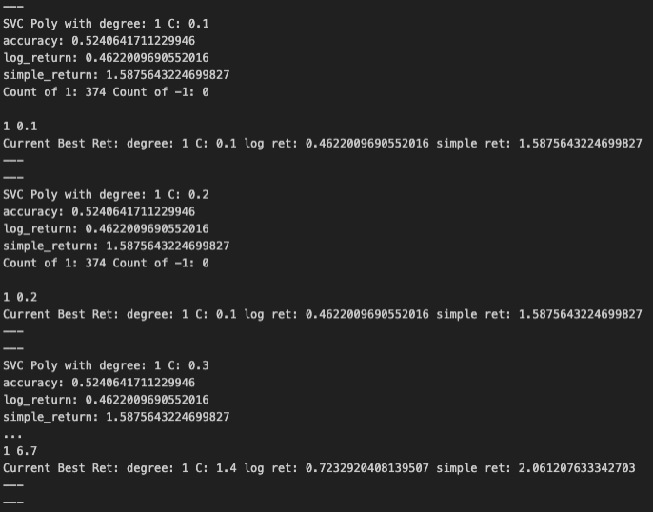
Machine Learning Training and Optimization 5:
SVM Poly Kernel Hyperparameter Tuning
Notes:
For the hyperparameter tuning, we used grid search brute force and arrived at degree of 2 and c 0.3

Slide 28
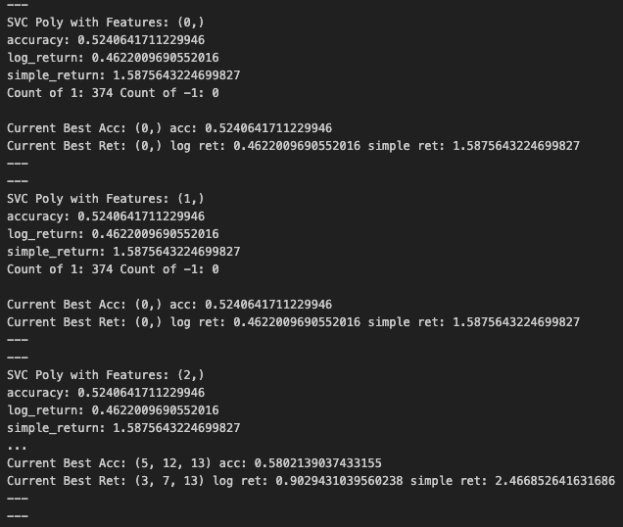
Machine Learning Training and Optimization 6:
Feature Selection
Notes:
We did the same brute force method for feature selection, where we tried to find the best subset of all the features which produce the best return

Slide 29
Machine Learning Training and Optimization 6:
Feature Selection
No. | Stock Names | Best Features
1. | Apple | 'SlowK', 'CCI', 'EMA', 'SMA_Short'
2. | Amazon | 'RSI', 'ADX', 'Aroon Down', 'Aroon Up', 'OBV', 'Chaikin A/D', 'SMA', 'EMA', 'SMA_Long_Short'
3. | Microsoft | 'MSFT.O', 'SlowK', 'SlowD', 'RSI', 'ADX', 'Aroon Down', 'Aroon Up', 'Chaikin A/D', 'SMA', 'EMA', 'SMA_EMA_ratio', 'SMA_Short', 'SMA_Long', 'SMA_Long_Short'
4. | Intel | 'INTC.O', 'SlowD', 'Aroon Down', 'OBV', 'Chaikin A/D', 'SMA_EMA_ratio', 'SMA_Long_Short'
5. | Goldman Sach | ‘SlowK', 'SlowD', 'RSI', 'CCI', 'Aroon Down', 'OBV', 'Chaikin A/D', 'SMA_Short'
Notes:
These are the features selected and we can see that the external data we took and features we generated is used a lot here

Slide 30
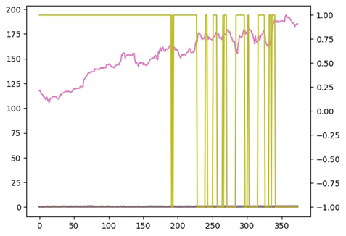
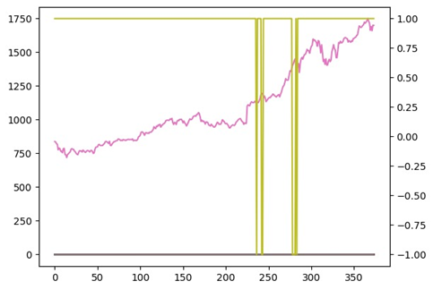
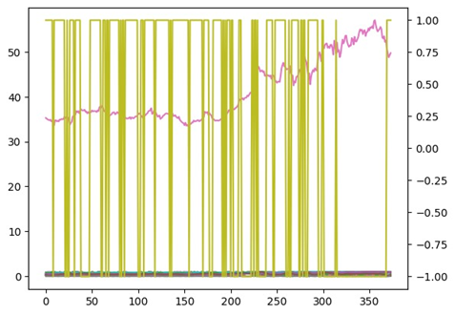
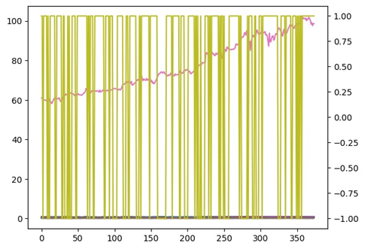
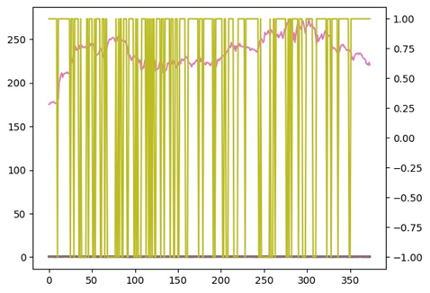
Simulation
AAPL.O
MSFT.O
AMZN.O
INTC.O
GS.N
Notes:
Before we go into the result, these are the positions our model took during the simulation. Aapl and amzn did significantly less position change than the other. You might be able to guess how the results are from these.

Slide 31
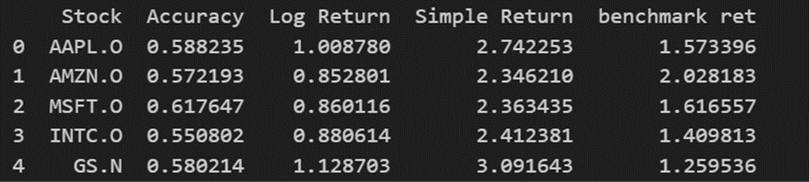
Result
Notes:
From the simulated trading we have done. Note that our benchmark case is if we just long until the end. We managed to get better returns in all of them. GS performs the best, both in term of simple returns and comparison to the benchmark. Meanwhile Amazon is the opposite of it, where it perform worst on both metrics. There’s one interesting thing I would like to highlight. If we compare gs and microsoft, we see that accuracy doesn’t always mean better result return, I would say it is a good start or indicator to returns.

Slide 32
Challenges
Research & Selection
Collaboration
Failures
Notes:
The main challenges we faced during the research were:
Selecting the model: We tried many different approaches initially such as predicting the stock prices using Lag data, Other Neural Network model but..
Collaboration: It was really challenging for us to find a time where everyone was available and work together.
Failures: As discussed, using the Lag data approach produced a lot of false predictions and the number of trades were really high. Overfitting was also a challenge we encountered.

Slide 33
Lessons Learned
Data is key
Make decisions early on, make time in case of failures
Sanity check
Communication
In general, accuracy correlates positively with returns

Slide 34
Possible Improvements
Combination of methods
Information
Trading strat
Risk management
Testing
model
Notes:
Some Possible improvements for the future would be:
Using ensembling methods to reduce overfitting
Explore ways to utilize relevant information such as “unseen” data or other financial indicators could allow a better model to be created.
Testing more rigorously
Implementing more trading strategies and compare with our models

Slide 35
Thank You!

